Slide 1
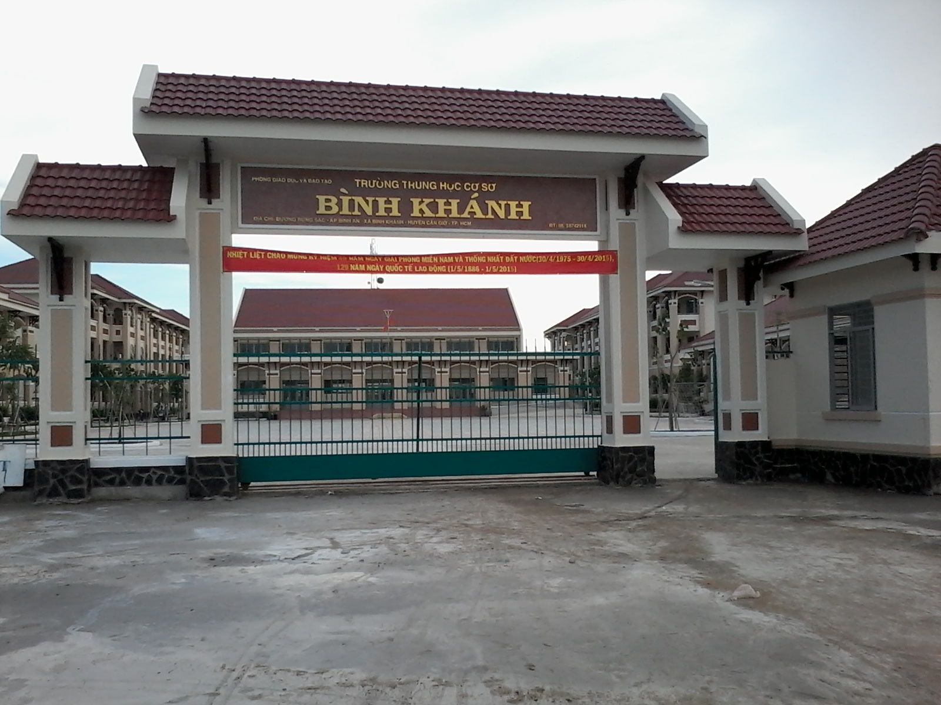



BINH KHANH SECONDARY SCHOOL
FRIENDS PLUS 6

Slide 2

HIDDEN PICTURES

Slide 3
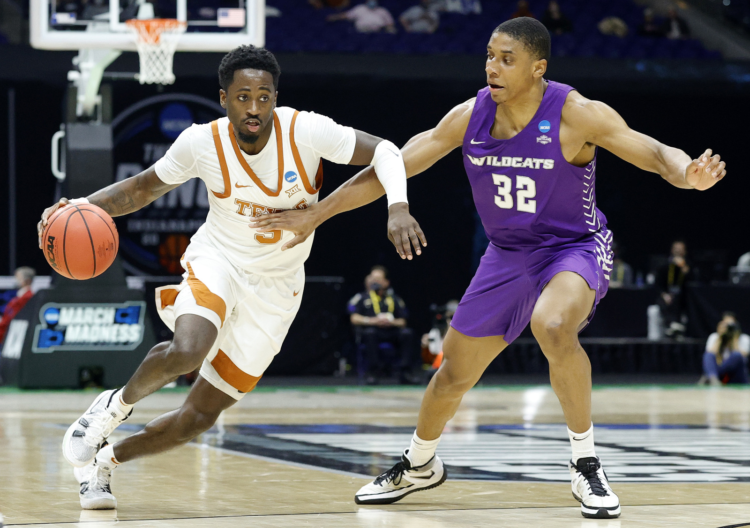
basketball

Slide 4
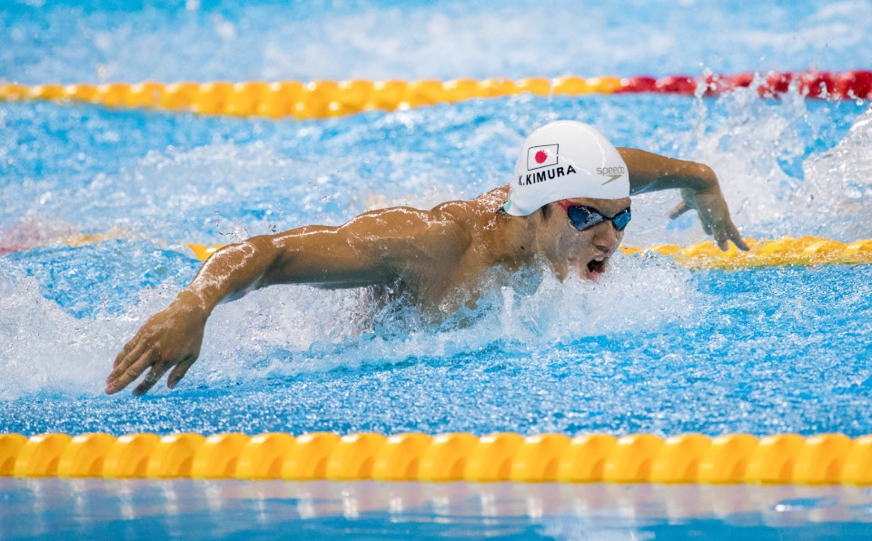
swimming

Slide 5
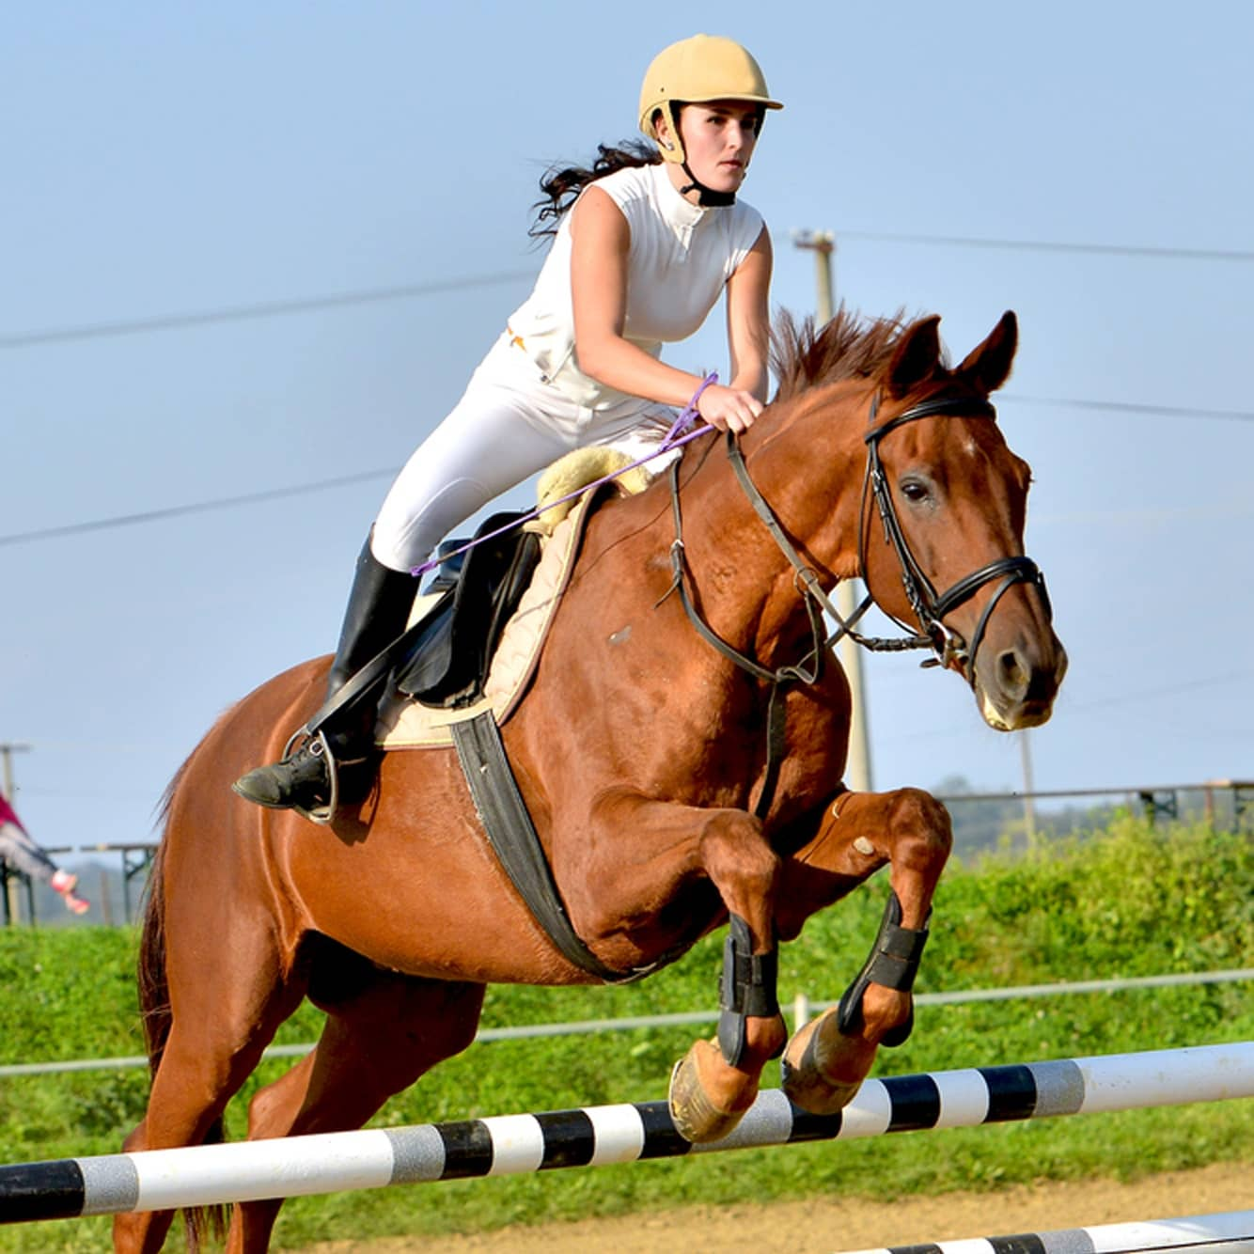
horse - riding

Slide 6
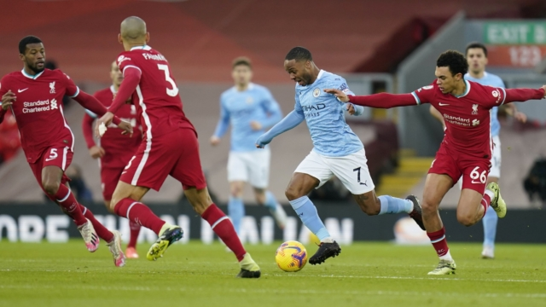
football / soccer

Slide 7
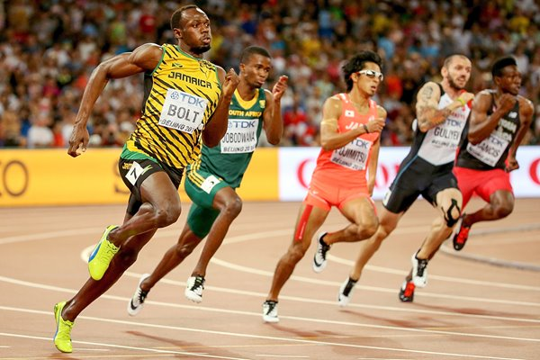
athletics

Slide 8
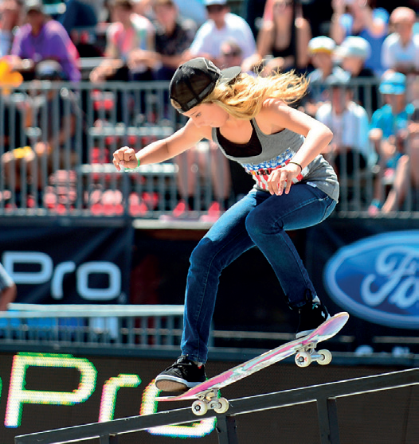
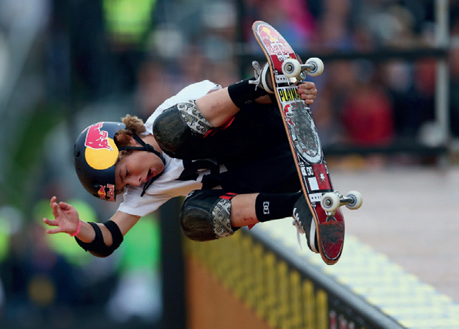
Alana
Tom

Slide 9
What can you remember about Alana and Tom?

Slide 10

UNIT 6
SPORTS
Lesson 5: language focus

Slide 11

have got
1) Regular verbs _____________ past simple forms ending in -ed.
haven’t got
2) Irregular verbs ______________ past simple forms ending in -ed.
have got
3) Verbs in the past simple ___________ the same
form for I, you, he, she, it, we and they.

Slide 12


Slide 13
SIMPLE PAST TENSE – AFFIRMATIVE
- Usage:
Simple past tense is used to talk about the action that happened in the past.
Ordinary verb
Regular verb (V_{ed})
Irregular verb (V₂)

Slide 14
Regular verb (Ved)
With most regular verbs, we add -ed to the base form of the verb.
Ex: play → played
start → started
call → called
With verbs ending in -e, we just add -d.
Ex: like → liked
compete → competed

Slide 15

FORM:
S + V_{2/ED} + O
Ex: I talked to him yesterday.

Slide 16

Read the Study Strategy

Slide 17
STUDY STRATEGY
Learning irregular verbs
- It’s important to check the past simple forms of verbs and learn the irregular ones.
- Put the verbs in groups of ten and try learning a different group every week.

Slide 18
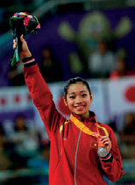
Complete the YOUNG SPORTS SUPERSTARS text with the past simple form of the verbs in blue
Phan Thị Hà Thanh (1) (start) ___________ gymnastics when she was six. She (2) (go) __________ to an athletic training centre in Hải Phòng. In 2011, she was the first Vietnamese gymnast who (3) (win) _________ a world medal for Việt Nam and she (4) (compete) ____________ in the Olympic Games in 2012 and 2016.
started
went
won
competed

Slide 19
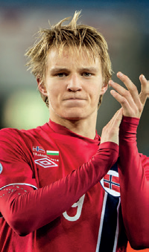
Martin Odegaard, from Norway, (5) (become) ___________ a professional footballer at fifteen and (6) (score) ____________ great goals for his club. He first (7) (play) ___________ international football before he was sixteen. A lot of famous clubs were interested in him and he (8) (train) ____________ with some of them. Finally, in 2015, Real Madrid (9) (give) ___________ him a contract.
became
scored
played
trained
gave

Slide 20


Slide 21

Listen and repeat the words
1) /t/: practised, watched
2) /d/: travelled, played
3) /ɪd/: started, decided

Slide 22

PRONUNCIATION “-ED”
- /id/: /t, d/
Ex: wanted, ended
- /t/: /p, f, s, k, ʃ, ʧ/
Ex: talked, watched, brushed
- /d/: all other sounds
Ex: lived, played

Slide 23

Which letters come before the -ed ending in list 3?
‘t’ and ‘d’

Slide 24
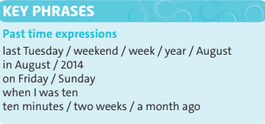
Read the Key Phrases

Slide 25
Look at the examples and answer the questions
He first competed when he was twelve.
She last competed in 1981.
He was on this programme two years ago.
1) How do you say the words in blue in your language? 2) Do we put “ago” before or after a past time expression?
after

Slide 26
Write sentences using the past simple and the Key Phrases. Then compare with other people in the class. Are any of your sentences the same?
I first (watch) the Olympics …
I last (do) my English homework …
I first (come) to this school …
I first (swim) in a pool …
I last (see) a good film …

Slide 27
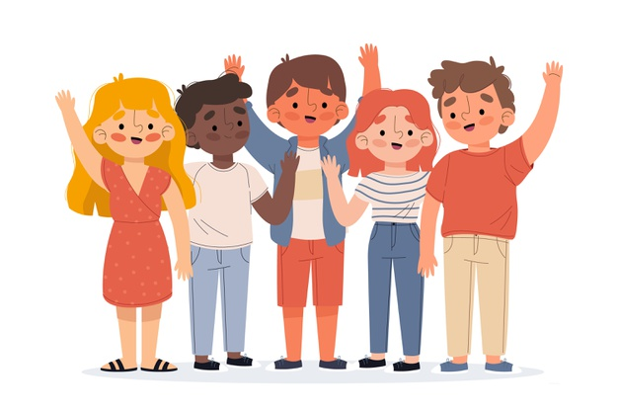
HOW POPULAR ARE YOU?

Slide 28
Write true and false statements about your life. Use the verbs on this page.
Example sentences:
I went to shopping center last month.
I studied English when I was 6.

Slide 29

Homework
- Learn by heart all structures.
- Workbook: Exercises on page 45.
- Prepare the next lesson: SPEAKING

